Slide 1

Memory efficient w-projection with the Fast Gauss Transform
Keith Bannister
Bolton Fellow
CSIRO Astronomy & Space Science
keith.bannister@csiro.au
With Tim Cornwell (now at SKA)

Slide 2
Outline
What is w-projection?
Why is important?
Gaussian anti-aliasing functions
W-projection with The Fast Gauss Transform
Results
Conclusions

Slide 3
Conclusions First
This method (Bannister & Cornwell 2013) is one of a class of algorithms knows as ‘Bannister & Cornwell’ algorithms
Theoretically very interesting
But practically useless
C.f. also Bannister & Cornwell 2011.

Slide 4
W-projection
Antennas usually aren’t on a flat plane in uv (i.e. they have different w)
As you go away from the phase center (e.g. for wide-field imaging at low frequencies):
  Wavefront curvature becomes important
  i.e. The delay compensation for each baseline changes as a function of position on sky
  i.e. Image looks bad

Slide 5
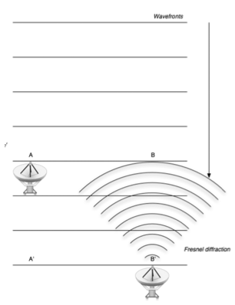
Look! Diffraction/curved
wavefronts
Cornwell+ 08

Slide 6
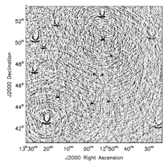
Look!
Image distortion

Slide 7
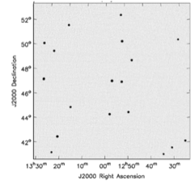

Slide 8
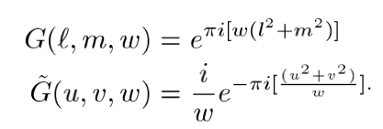
The solution: W-projection
Standard Imaging =
  Grid visibilities with antialisaing (AA) function
  Fourier transform the living daylights out of it
+ that w-projection goodness:
  Build the curved wavefront into the convolution function
  i.e. Convolve the AA function by a complex Gaussian:

Slide 9
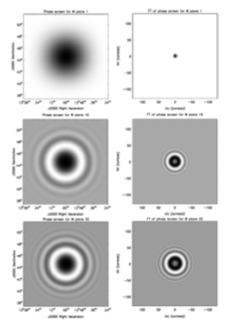
Cornwell+ 08

Slide 10
Gaussian anti-aliasing functions
The w kernel is a complex Gaussian
If the anti-aliasing function is a complex Gaussian
Then the resulting convolution function is also a complex Gaussian

Slide 11
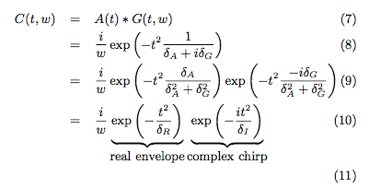
You can’t keep a Gauss-i-an down
The convolution of 2 Gaussians
Is also a Gaussian
Which is also the product of
2 Gaussians
i.e. a real envelope + complex
chirp
LaTeX drives me crazy
Incidentally the FT is also Gaussian

Slide 12
The Fast Gauss Transform (Strain 1991 )
Came out of the flurry of activity from the development of the Fast Multipole Method (Greengard & Strain 1991)
2 step process:
  Take the position, width and height of the Gaussian, and update a set of Taylor coefficients on a grid
  Evaluate the Taylor coefficients at every point on the uv plane
It’s parameterized by 2 numbers:
  L - the size of the box in pixels (can be <1 or > 1 in theory)
  p – The number of Taylor coefficients to store & update

Slide 13
Terminology

Slide 14
Error pattern
Error from finite range (i.e. truncation of support)
uvplane
image plane
Error from truncation of Taylor series

Slide 15
Optimisations
For large Gaussians (big w), don’t update all the Taylor coefficients
Make the box size > 1 uv-cell
Play games with error (cheat)

Slide 16
Predictions
20x more FLOPS
than standard gridding
10x less memory bandwidth
than standard gridding

Slide 17

Results – L ~ 1
Worst fractional error in image plane

Slide 18

Error – L~ 2

Slide 19
Computation time L~1
10-100x slower than normal gridding ☹
Dominated by CEXP

Slide 20
Conclusions & ideas
No need to store or calculate convolution functions: shape built into Taylor series
Can parallelize across Taylor coefficients (i.e. each node only stores/updates certain Taylor coefficients)
Tunable gridding error: reduce gridding error with major cycles – so that first major cycles finish quickly
FGT may still have legs:
  Mapping between w and q’ could be better
  Maybe the way I’m using it for complex data is sub-optimal
Can we use the more general fast multipole method for prolate spheroidal wavefunction * w kernel?

